Slide 1

HPS ONGOLE
A
Think School
Initiative
A SCHOOL WITH A DIFFERENCE.
1. We believe that we belong to this generation if so our brains either belong to this generation ?
2. Do we just need NEXT-GEN or SMART GEN kids?
JAGADISH NANDIPATI

Slide 2
What are we up to?
2016:
47 kids, 6 teachers, 4 janitors, 2 drivers.
2022: More than 560 kids with 34 teaching staff @16:1 & 21 non-teaching staff, class-8.
2023-24:
The Best school in town with a new prep branch. Updated activities like basket ball, volley ball etc..
2018:
Class-4, 251 students, 15 teachers.
2020
The only new school in the state despite corona with 252 kids & 14 teachers, class-6.
2026:
Unique campus with all the affordable amenities up to Class-12.

Slide 3

Admission Process:
How it works:
1
No New sections.
Admissions from the parents’ references only.
2
Admissions are open only for select a few classes.
3
No new students without a prior and proper scrutiny.
4
Recruitment of dedicated and enthusiastic teachers.
5

Slide 4

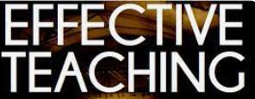
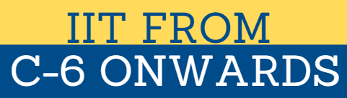
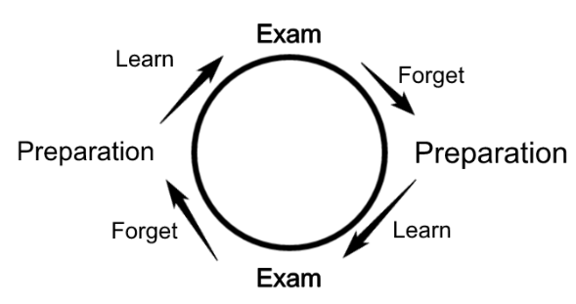

What’s New ?
The initial days were very hard to deal with the kids.
It is easy come, teach, complete the text book and go but very hard to take the responsibility on kids’ holistic growth.
Holistic growth is required but greatly not riot learning.
IIT classes, a true IIT classes..
Keen focus on soft and communications skills. English has given much priority which yielded good results. Hosting by c-3 kids is the best result.

Slide 5


2023-24: A Decent upgrade in the Curriculum:
Invested a lot of time & Energy,
met tens of intellects & spoke to tens of schools…
A leap in upgrading our curriculum.
A perfect blend of digital & conventional education.
More of learn & explore,
explore & analyse pattern of education.
It definitely helps us in bridging the gap between the students who study in cities & our kind of towns

Slide 6
The world is NOT about
when, who, where or what but it is all about
WHY?

Slide 7
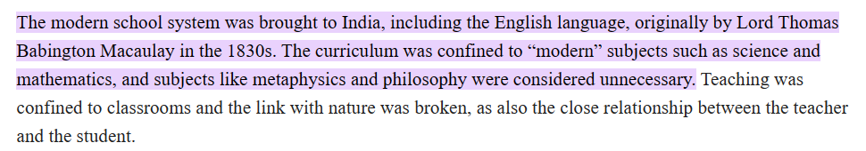
OUR EDUCATION IS DESIGNED FOR?

Slide 8


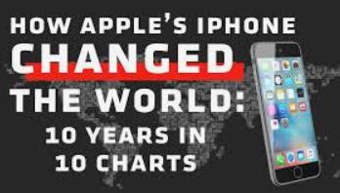

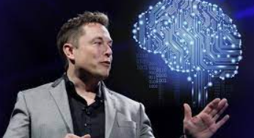
Jobs & Businesses: Past to Future:
Jobs which were existed 10 years ago do not exist now.
The jobs exist now may not exist 10 years later.
The jobs will exist 10 years later may not be imaginable right now.
WE NEED TO PREPARE OUR KIDS FOR THE WORLD WHICH DOES NOT EXIST YET.

Slide 9
WHAT DO WE NEED IN SCHOOLS NOW?
We need a true education which inculcates the REQUIRED qualities but
not only the traditional subjects anymore.
Self-Regulation, social stimulation, ADOPTABLE & AGILISTIC, Soft Skills, Communication Skills, HR Management, Financial Literacy, Mental ability, Critical Thinking, Analytical skills, Innovation, creativity, Entrepreneurship & Technology etc..

Slide 10
Technology inbuilt Education with values:
“If we teach today’s students as we taught yesterday’s we rob them of tomorrow”
There is a precise irrelevance between our childhood studies & jobs we are doing.
The world which we were grown up is completely different from the current’s in terms of everything. Everything from our generation have been updated, upgraded whereas 95% of the current education pattern matches with ours.
How relevant our brains with the present and future?
Don’t we upgrade?
A Few advantages:
Students will be up to date with the real world.
Prepares students for the workforce.
It suits all the types of learners.
An easy access to the information.
How to be responsible when we are engaging with the technology.
Parents stay connected with their children to help them.
No upgrade? - no future.

Slide 11
Let’s work together for our NEXT SMART Generation.
Now, just think where our brains belong to?
Current or Previous generation’s?
Jagadish Nandipati
THANK YOU

